Slide 1

HR AND ADMIN

Slide 2
สารบัญ
User story
Languages
System user case
System user case for User
System user case for Admin
System user case for HR
System user case for Manager
System user case for Supervisor
EMPLOYEE
Employee master
Class diagram employee
Activity diagram employee master
User interface employee master
New employee master
Activity diagram new employee master
User interface new employee master
Create new account
Activity diagram create new account
User interface create new account
ATTENDANCE
Attendance
Class diagram attendance
Activity diagram attendance
User interface attendance
Data Attendance
Activity diagram data attendance
User interface data attendance
Approve by supervisor
Activity diagram approve by supervisor
User interface approve by supervisor
Approve by manager
Activity diagram approve by manager
User interface approve by manager

Slide 3
OVER TIME
Over time
Class diagram over time
Activity diagram over time
User interface over time
Data over time
Activity data over time
User interface data over time
Approve over time
Activity approve over time
User interface approve over time

Slide 4
User story
ในฐานนะเจ้าหน้าที่ HR
ฉันต้องการระบบ ลางาน,โอที ผ่านเว็ปไซต์หรือออนไลน์ โดยผ่าน manager และ supervisor
เพื่อสะดวกและรวดเร็วในการจัดการ

Slide 5
ภาษาที่ใช้
JAVA
HTML
CSS
Type Script
Framework Angular

Slide 6
SYSTEM USE CASE

Slide 7
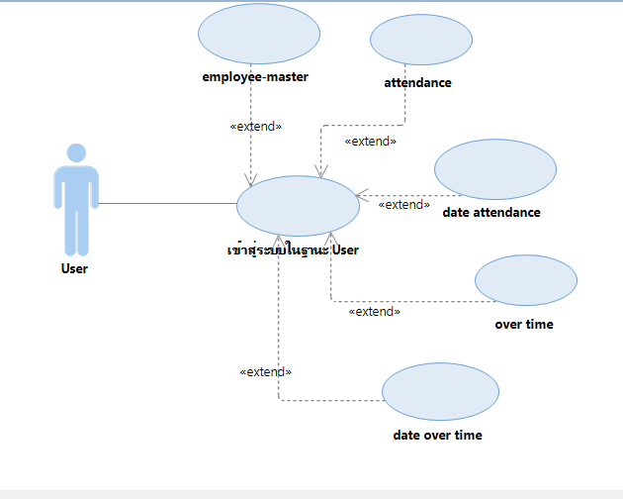
System Use Case For User

Slide 8
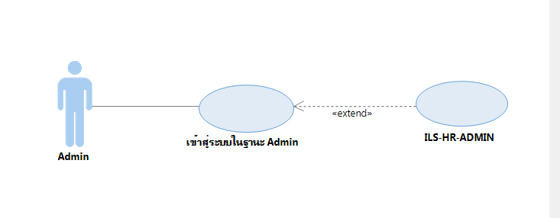
System Use Case For Admin

Slide 9
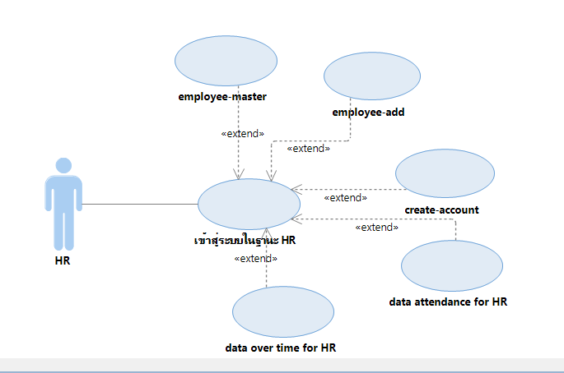
System Use Case For HR

Slide 10
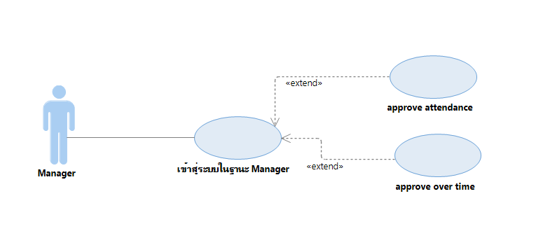
System Use Case For Manager

Slide 11
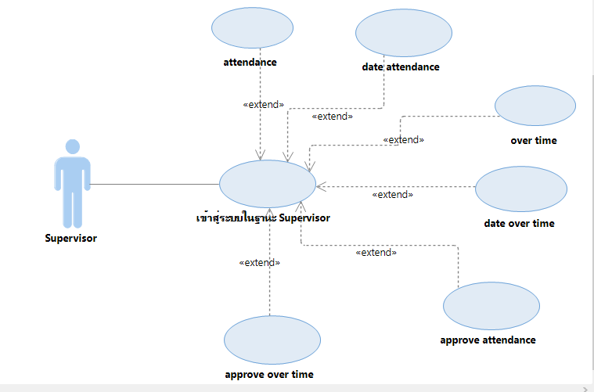
System Use Case For Supervisor

Slide 12
EMPLOYEE MASTER

Slide 13
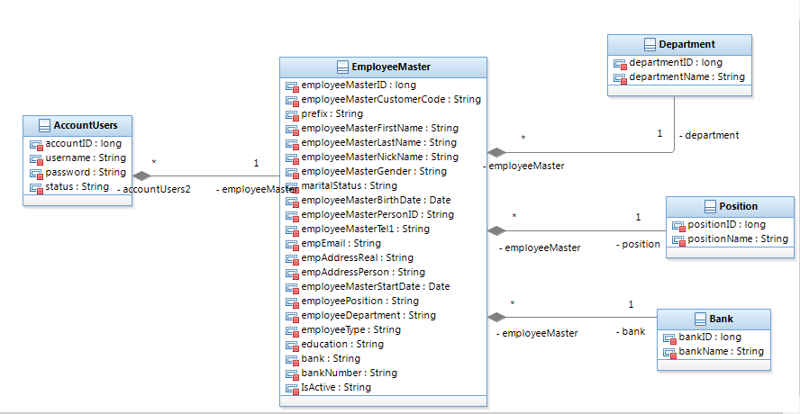
Class Diagram Employee

Slide 14
Activity Diagram Employee master

Slide 15
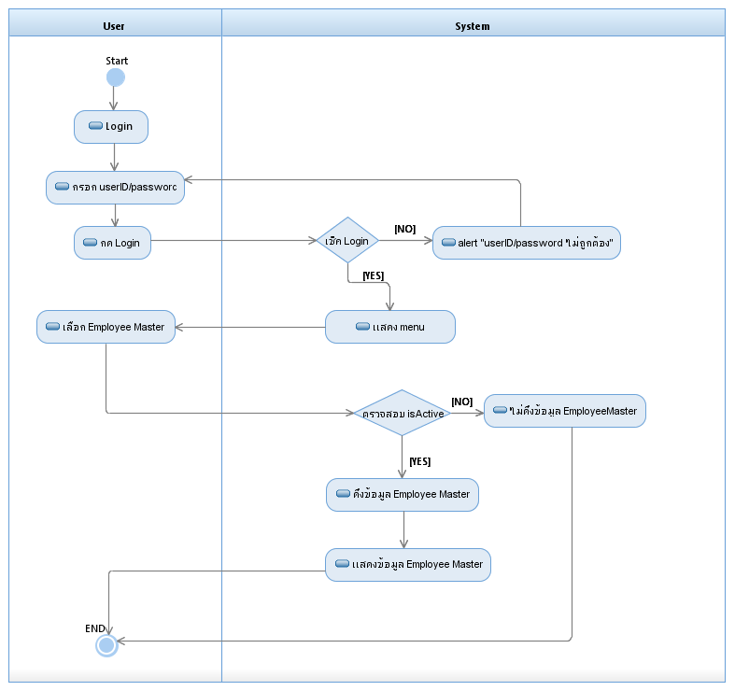

Slide 16
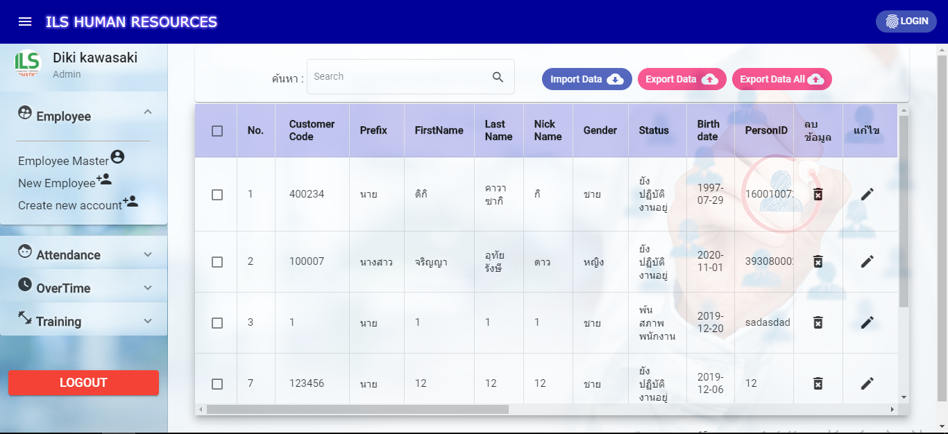
User Interface Employee master

Slide 17
NEW EMPLOYEE MASTER

Slide 18
Activity Diagram
New employee

Slide 19
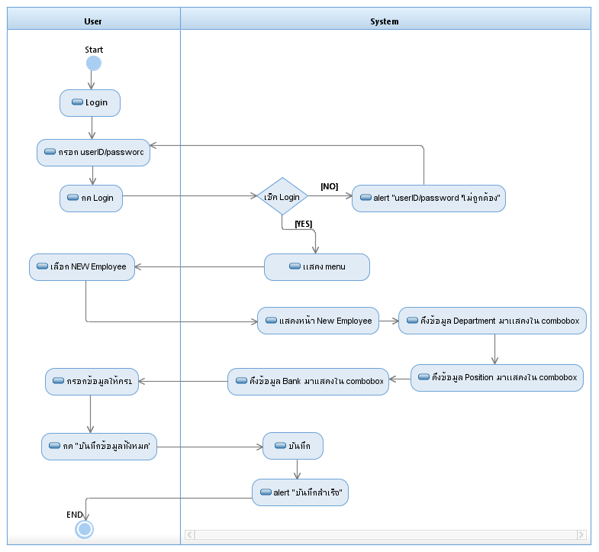

Slide 20
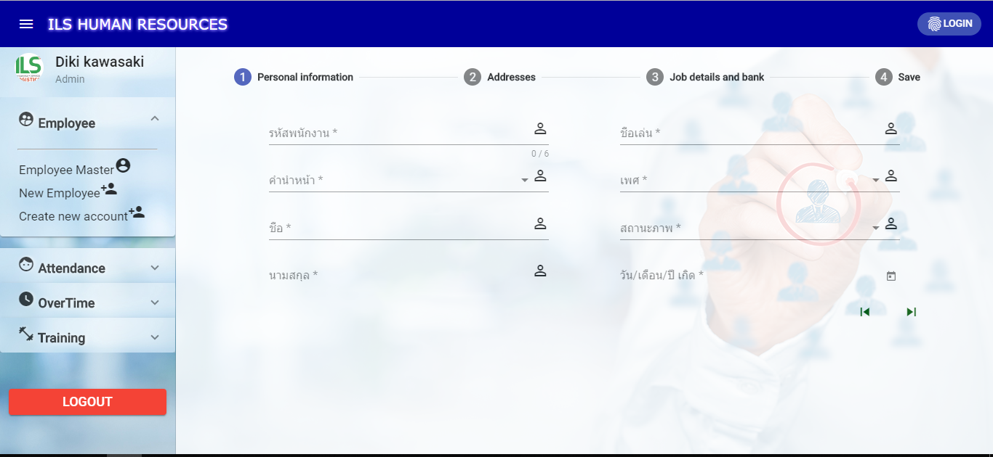
User Interface New Employee master

Slide 21
CREATE NEW ACCOUNT

Slide 22
Activity Diagram
Create new account

Slide 23
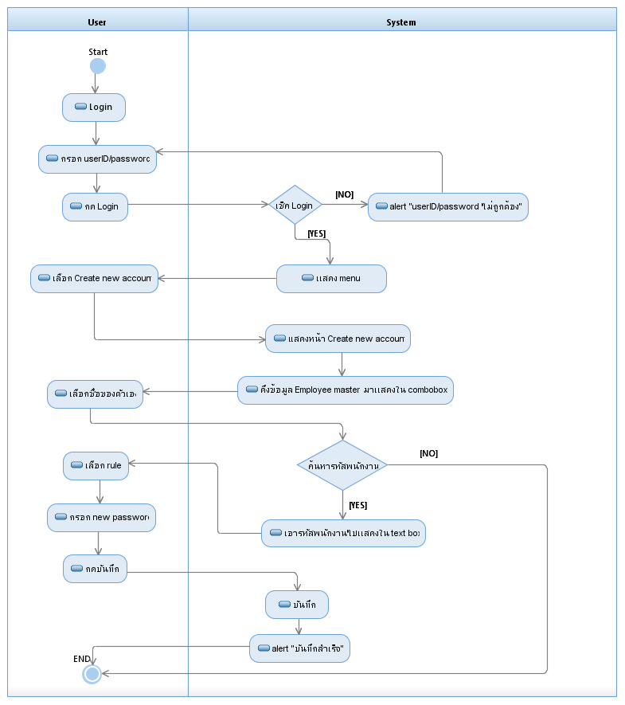

Slide 24
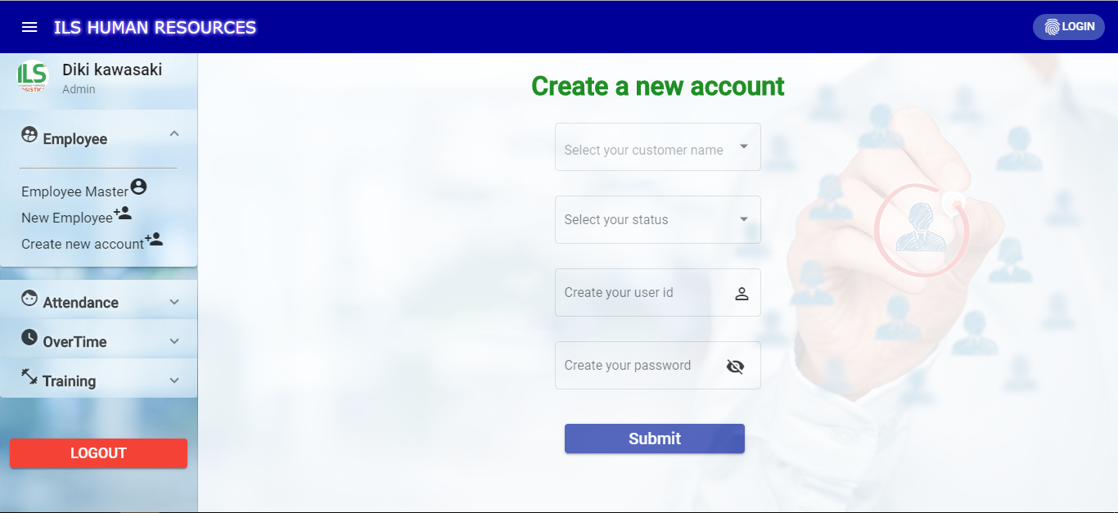
User Interface Create new account

Slide 25
ATTENDANCE

Slide 26
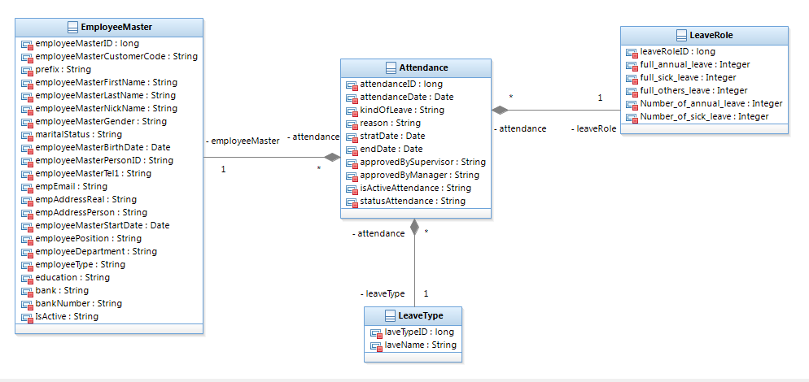
Class Diagram Attendance

Slide 27
Activity Diagram Attendance

Slide 28
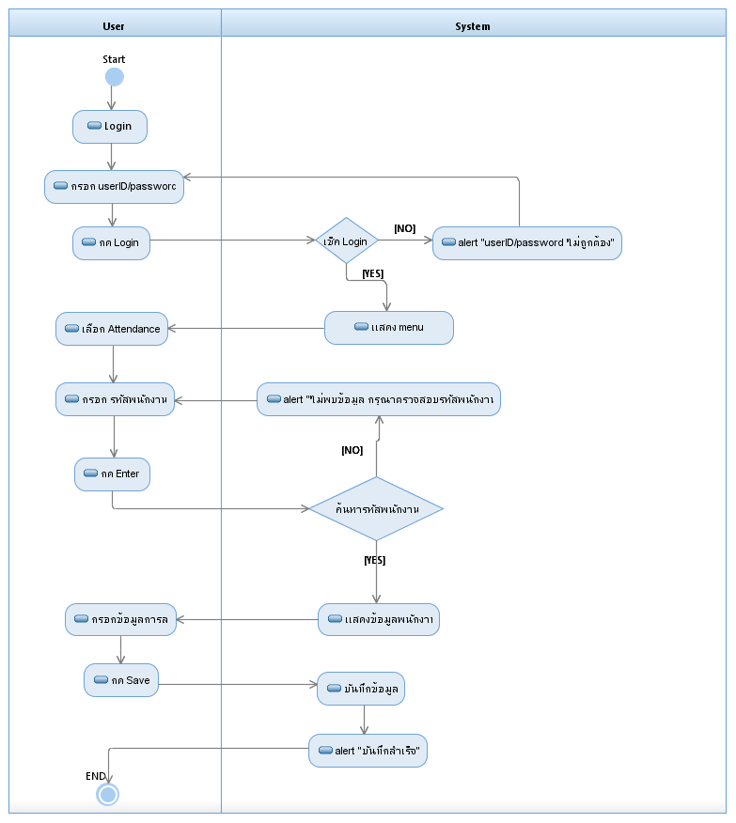

Slide 29
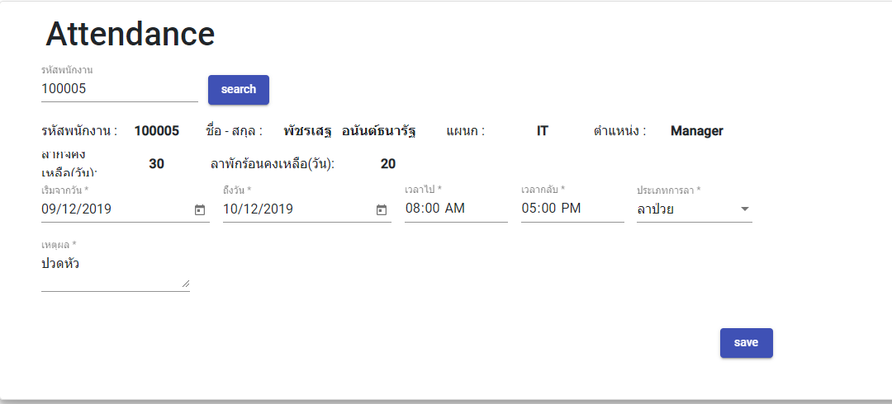
User Interface Attendance

Slide 30
DATA ATTENDANCE

Slide 31
Activity Diagram
Data Attendance

Slide 32
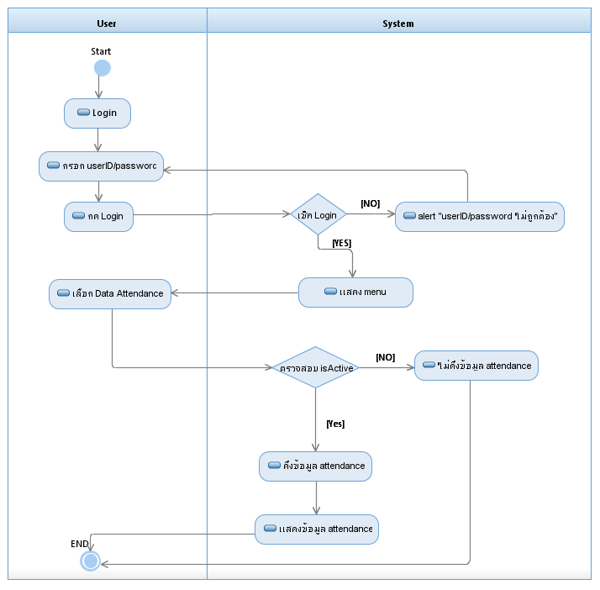

Slide 33
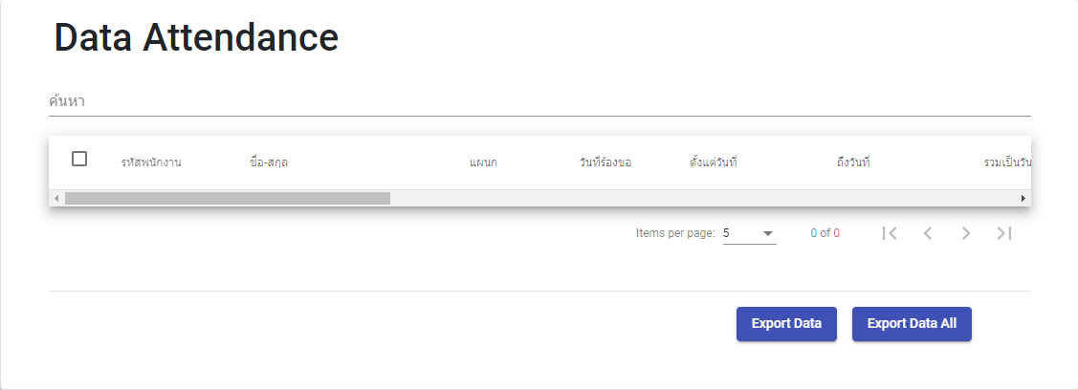
User Interface Data attendance

Slide 34
APPROVE BY SUPERVISOR

Slide 35
Activity Diagram
Approve by supervisor

Slide 36
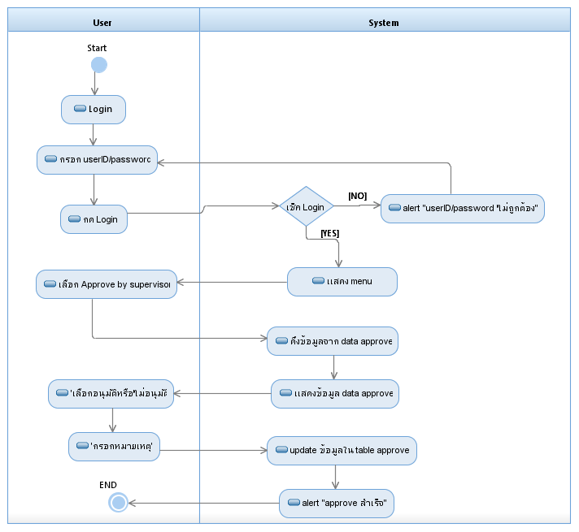

Slide 37
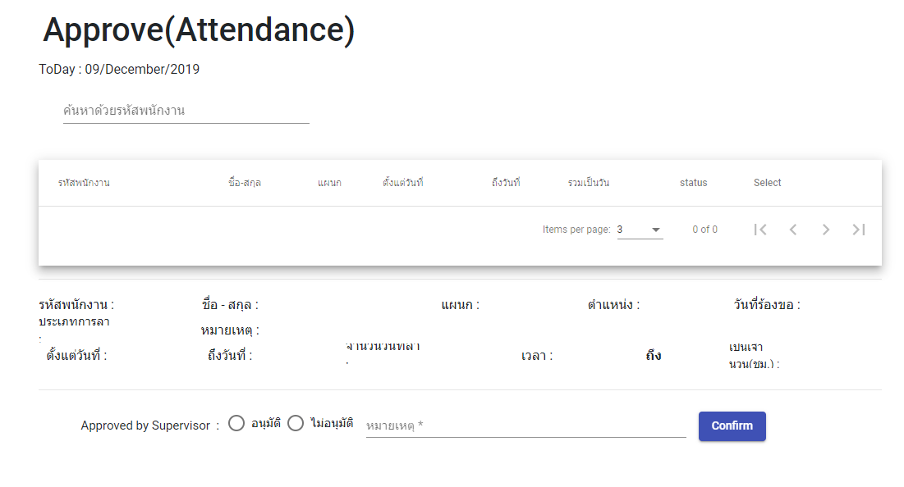
User Interface Approve by supervisor

Slide 38
APPROVE BY MANAGER

Slide 39
Activity Diagram
Approve by manager

Slide 40
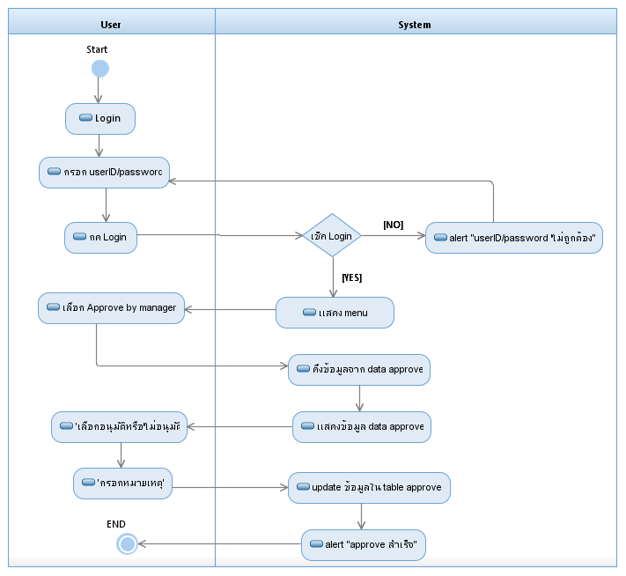

Slide 41
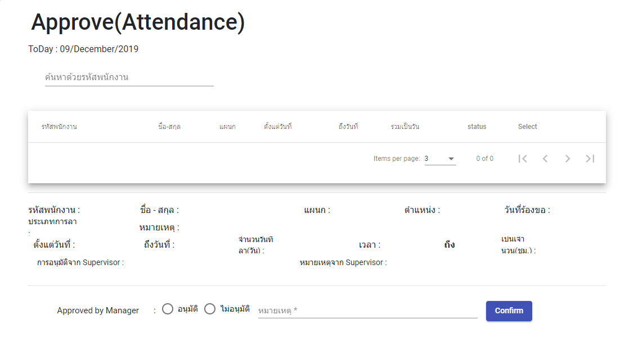
User Interface Approve by manager

Slide 42
OVER TIME

Slide 43
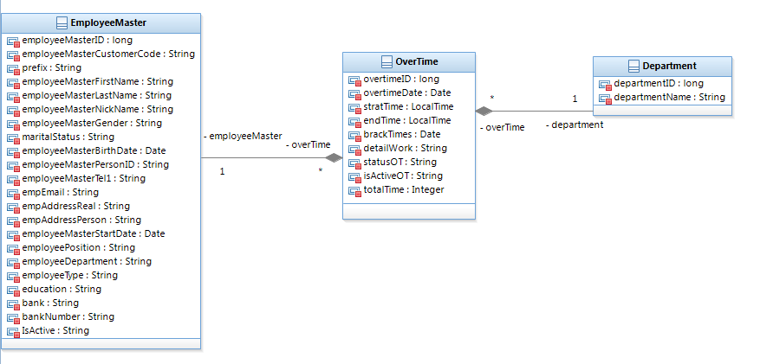
Class Diagram Over Time

Slide 44
Activity Diagram
Over Time

Slide 45
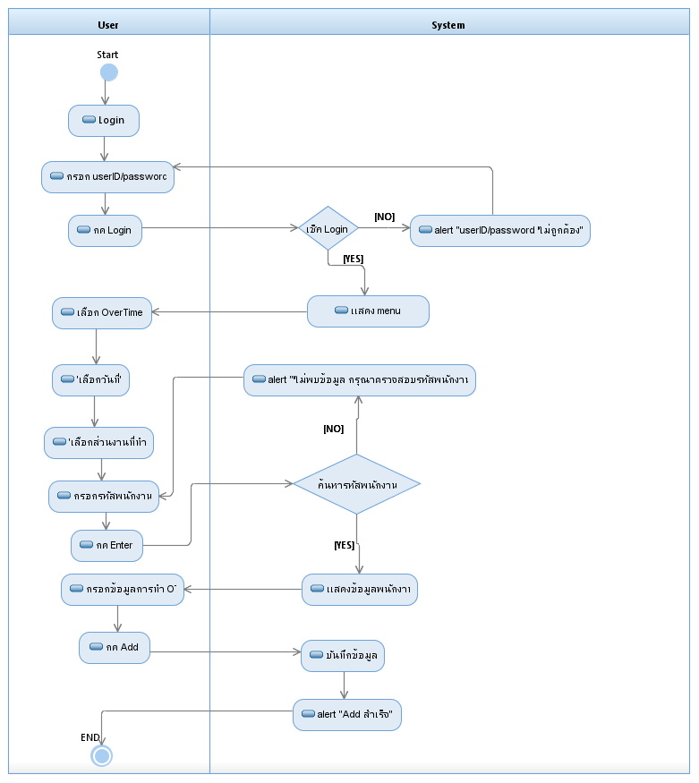

Slide 46
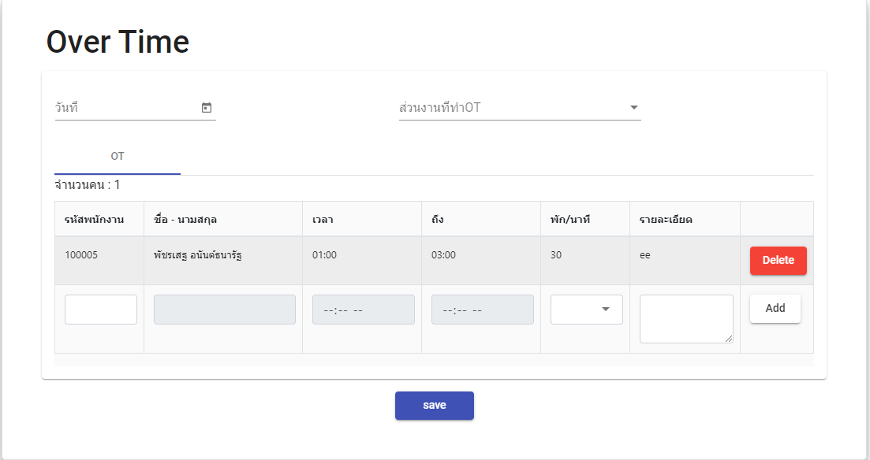
User Interface Over Time

Slide 47
DATA OVER TIME

Slide 48
Activity Diagram
Data Over Time

Slide 49


Slide 50
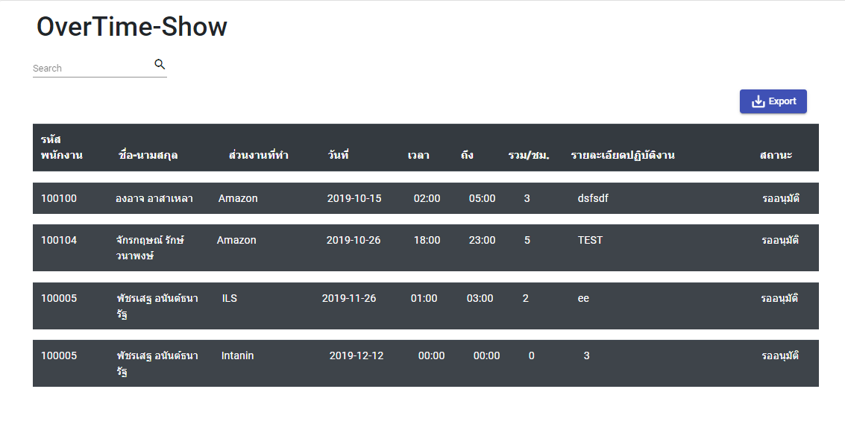
User Interface Date Over Time

Slide 51
APPROVE OVER TIME

Slide 52
Activity Diagram
Approve Over Time

Slide 53
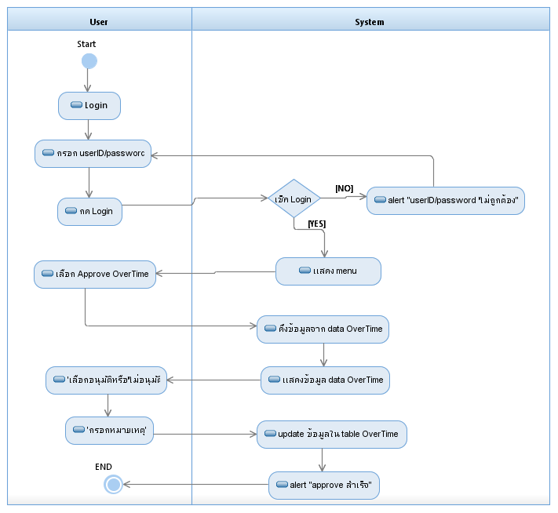

Slide 54
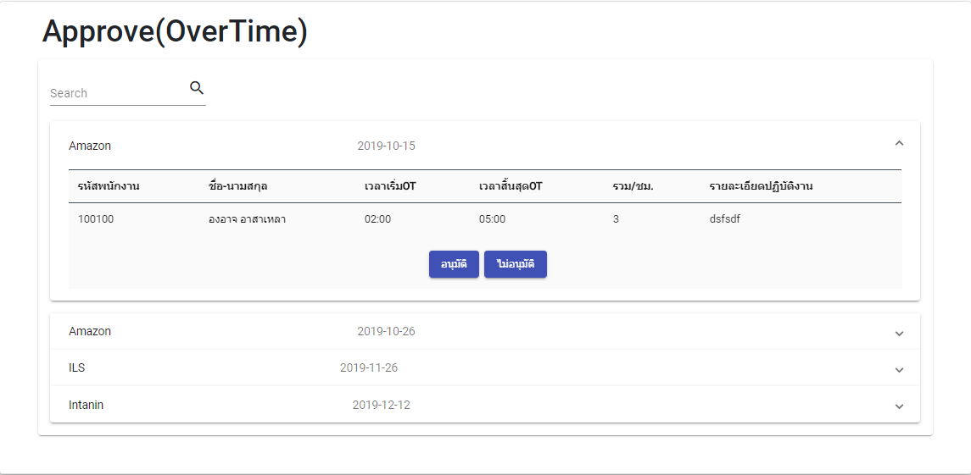
User Interface Approve Over Time

